Slide 2
National Curriculum: Year 1
Children need to develop:
pleasure in reading;
motivation to read;
improved level of understanding.
increased vocabulary;
They will do this by frequently listening to:
stories;
poems;
information texts;
texts that they cannot yet read for themselves.
By reading with an adult, children can also be shown the processes of finding information within a book, such as the use of contents or index pages.
Notes:
Review the National Curriculum aims for year 1, highlighting the importance of motivating children to read both at school and at home. Highlight some methods of supporting parents with motivating children to want to read. You may wish to mention the use of a reading reward chart to help children to get in good reading habits. Ensure that parent and carers also understand that a number of the skills needed will be developed by hearing adults read to them, not just necessarily by reading texts themselves. Discuss the impact of reading texts to children at a higher level than they can read for themselves in order to develop their vocabulary and understanding.

Slide 3
How to Help
Initially, reading with your child is about reading to them. Model clear reading with fluency and expression. Model how to read unknown words.
Read a range of different texts, such as: recipe books; nursery rhymes; instruction manuals; leaflets for places you wish to visit; traditional tales.
Show your child how to find information in a book rather than quickly finding it for them.
Notes:
Cover some initial ideas about how parents can support the National Curriculum aims highlighted on the previous slide. These ideas are also included in the Reading with Your Year 1 Child Parent Advice Booklet.

Slide 4
Phonics
The National Curriculum states that year 1 children must use phonic knowledge as their primary approach to reading unfamiliar words.
Children must be able to read all Phase 2, 3 and 5 graphemes by the end of year 1.
The reason that Phase 4 graphemes are not mentioned is that no new graphemes are taught. Instead, children consolidate their ability to blend words containing a range of consonant clusters.
Notes:
Ensure that parents and carers understand that the primary approach to developing reading skills in year 1 is using phonic knowledge. Phonics is taught in school on a daily basis and children focus on developing their understanding of a wide range of sounds. Highlight the sounds covered and their correct pronunciation.

Slide 5
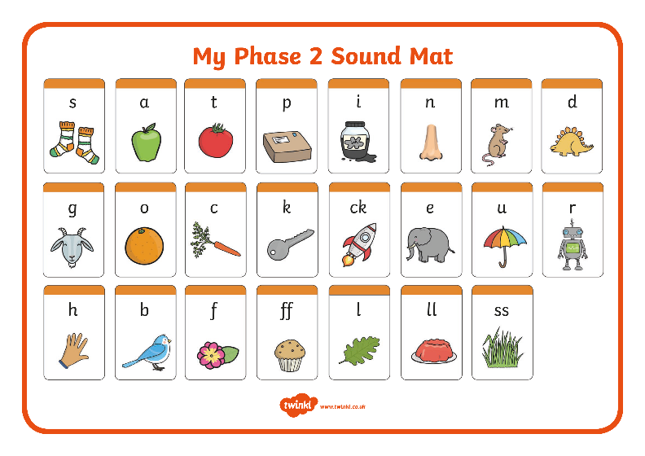
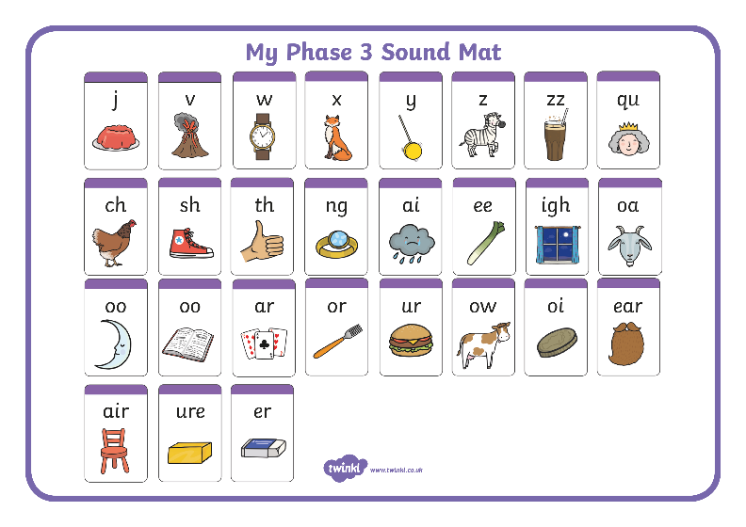
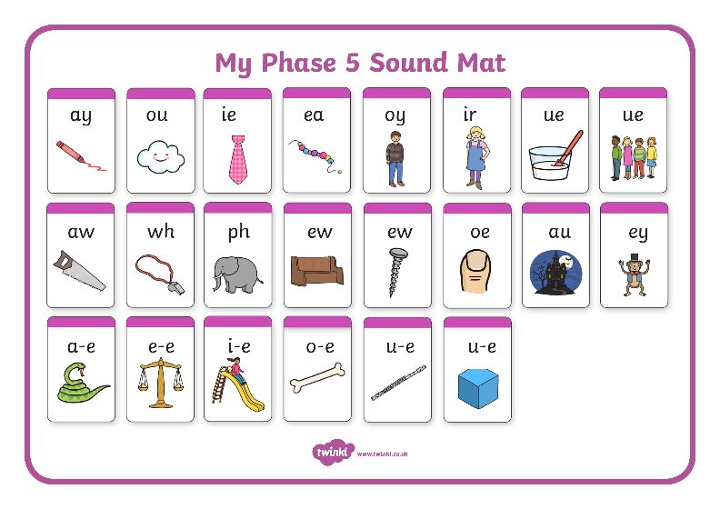
Sound Mats
Notes:
Highlight the sounds covered and their correct pronunciation. Share the sound mats that are included in the pack so that parents and carers are able to use them at home to support learning.

Slide 6
Tips to Help
Turn off the TV so that you can listen to and talk to your child. Model correct speech and pronunciation. Ask your child lots of questions.
Pretend to be a robot.
“Can you bring me your s-o-ck-s?”
Play ‘I Spy’ games. Can you find something beginning with…? How many… words can you see?
Ask your child to write the weekly shopping list.
Notes:
Model some of the suggested tips, particularly speaking in pure sounds like a robot. Explain that segmenting words in this way helps children to develop the skill of blending new words. Model segmenting and blending a number of words.

Slide 7
Tips to Help
Pretend that you are unable to read particular words within your child’s phonic knowledge and ask them to read them to you.
Pour flour, salt, rice or sugar on a baking tray and spell out words together.
Encourage your child to segment (break up) words into their sound parts and blend them (push them back together) to read the whole word.
Play with magnetic letters on the fridge. Can they spell ‘pan’?
Notes:
Model some of the suggested tips, particularly speaking in pure sounds like a robot. Explain that segmenting words in this way helps children to develop the skill of blending new words. Model segmenting and blending a number of words.

Slide 8
The Phonics Screening Check
In June, year 1 children are expected to complete the phonics screening check.
The aim of the check is to ensure that each child is making progress in phonics. Children are expected to read a mixture of real words and ‘nonsense’ words.
If a child has not reached the expected standard, schools must provide additional support to help the child to make progress in year 2.
Notes:
Introduce the year 1 phonics screening check which takes place each June. Pupils who have achieved the expected standard at the end of year 1 will have experience of decoding all of the types of words that appear in the year 1 phonics screening check. They will have extensive knowledge of grapheme-phoneme correspondence and they will be able to blend and read a range of words. Highlight the Guide for Parents Year 1 Phonics Screening Check handout included in the pack to give parents and carers more information.

Slide 9
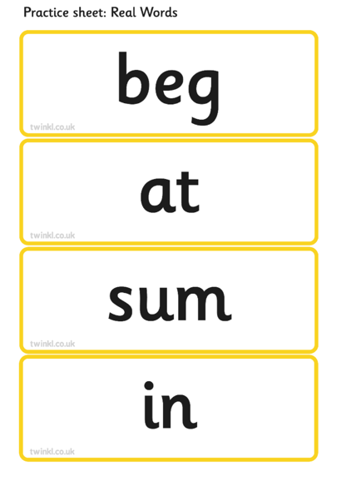
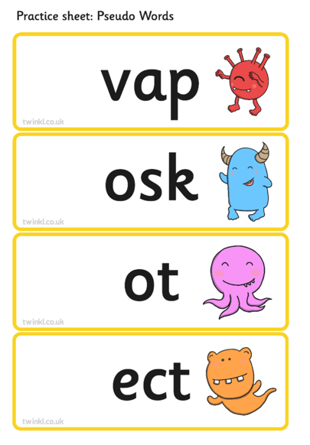
Example of the Year 1 Phonics Check Materials
Notes:
Show this example of words which could typically be seen in a phonics screening check. Explain that the test includes 40 unseen words that the children need to read. Half of the words are real words and half of the words are pseudo words. Pseudo words (often referred to as ‘nonsense’ or ‘alien’ words) are designed to test pure phonic ability rather than knowledge of commonly seen real words. Examples might include ‘baf’, ‘gip’, ‘leet’, ‘stoof’.

Slide 10
Year 1 Common Exception Words
Notes:
Share the Year 1 Common Exception Words handout and explain that pupils need to be able to read and spell these words by the end of the year.

Slide 11
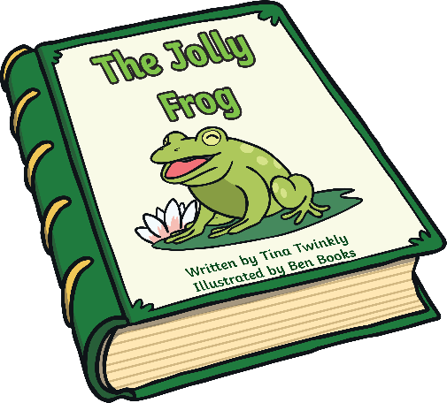
Reading for Understanding
What is happening? Talk about what is happening in the pictures before you read the text. What can you see?
Discuss the setting of the story. Have you read another book with the same setting?
Start in the middle of a book. What do you think has happened before this point? What makes you think that?
Use a dictionary together to get your child used to exploring words for themselves.

Slide 12
Reading for Understanding
Make predictions. What do you think will happen next? What makes you think that? If their prediction is off the mark, model your own and give your reasons.
Discuss alternative words, e.g. ‘Which word could the author have used that’s a bit more exciting than big?’ Use a thesaurus together.
Have you learnt anything while reading this book that you didn’t know before? Pretend that you have learnt a new fact and explain it.

Slide 13
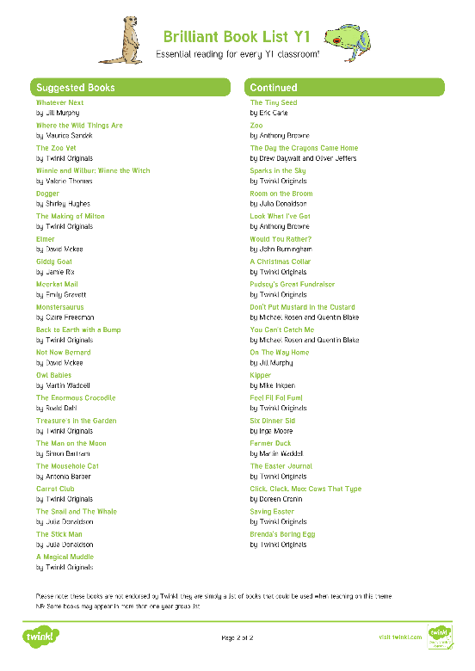
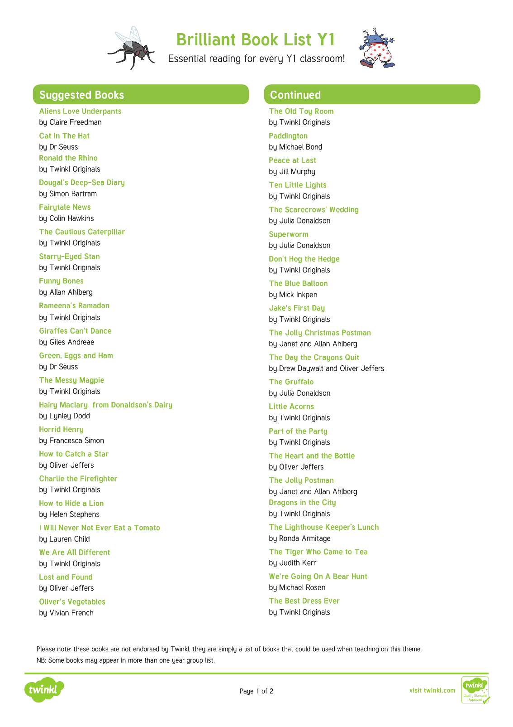
Brilliant Book List Y1
Notes:
Share the Brilliant Book List Y1. Highlight that these are only suggestions of books that might be good to read together with your child throughout the year and do not provide an exhaustive list.

Slide 14
Helping Your Child at Home
Read with and to your child every day.
Talk lots about the books you share. Asking questions will help to develop your child’s understanding.
Look for and encourage opportunities to read, such as by reading signs, menus or shopping lists.
Play games with sounds and words.

Slide 15
Reading Every Day
Reading to your child every day is just as important as hearing your child read to you.
Reading to your child will help your child to develop their understanding of what they hear. It can also inspire them to want to read for themselves.
Try to read to your child at a higher level than they can read by themselves.
Remember to talk about new words you come across together.

Slide 16
Reading Every Day
Talking about books is important for all children. While reading each night, try to ask these questions:
What was the book about? Was your prediction correct?
Look at the front cover. Can you guess what this book will be about?
Did you like the book? Why/why not?
What do you think that the word __________ means?
Does this book remind you of any other book we've read?

Slide 17
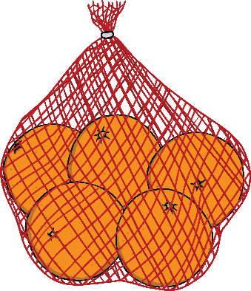
Reading Game Ideas
Playing simple reading games will help your child to see the relevance of reading while having fun.
Ask your child to read out and tick off the items on your shopping list as you shop.
Notes:
Share some simple games and ideas that families can do together at home to inspire a culture of reading.

Slide 18
Reading Game Ideas
Playing simple reading games will help your child to see the relevance of reading while having fun.
Ask your child to collect the mail from the doormat and read the name on each letter.
Notes:
Share some simple games and ideas that families can do together at home to inspire a culture of reading.

Slide 19
Reading Game Ideas
Playing simple reading games will help your child to see the relevance of reading while having fun.
Split up words into sounds using a robot voice to help your child to learn how to blend. Add a robot word into a sentence or question. Can you get your c-oa-t?
Notes:
Share some simple games and ideas that families can do together at home to inspire a culture of reading.

Slide 20
Reading Game Ideas
Playing simple reading games will help your child to see the relevance of reading while having fun.
Encourage your child to read signs, menus or notices when you are out and about.
Notes:
Share some simple games and ideas that families can do together at home to inspire a culture of reading.

Slide 21
Reading Game Ideas
Playing simple reading games will help your child to see the relevance of reading while having fun.
Hide notes with words or sentences on around the house. Encourage your child to hunt for them and to read the notes that they find.
school
Notes:
Share some simple games and ideas that families can do together at home to inspire a culture of reading.

Slide 22
National Curriculum: Year 2
Children need to develop:
pleasure in reading;
motivation to read;
increased vocabulary;
improved level of understanding.
While in year 2, children must add to this by learning about cause and effect in:
narrative texts, e.g. What has prompted the character’s behaviour in this story?
non-fiction texts, e.g. Why are certain dates commemorated annually?
This skill requires deep thinking and is easier for some children than others.
Notes:
Review the National Curriculum aims for year 2, highlighting the importance of motivating children to read both at school and at home. Highlight some methods of supporting parents with motivating children to want to read. You may wish to mention the use of a reading reward chart to help children to get into good reading habits. Ensure that parent and carers also understand that a number of the skills needed will be developed by hearing adults read to them, not just necessarily by reading texts themselves. Discuss the impact of reading texts to children at a higher level than they can read for themselves in order to develop their vocabulary and understanding.

Slide 23
How to Help
In everyday life, model explaining why you have made the decisions you have made, e.g. ‘I’m going to leave that there so that I remember it later.’
Continue to regularly model clear reading with fluency and expression.
Share your opinions about a book and explain why you think that.
Discuss appropriate national events and explain why they are celebrated annually.
Explain why people react the way they do within certain social situations.
Notes:
Cover some initial ideas of how parents and carers can support the aims highlighted on the previous slide. These ideas are also included in the Reading with Your Year 2 Child Parent Advice Booklet.

Slide 24
Year 2 Expectations
Year 2 children are expected to:
use a range of strategies to read new words, e.g. breaking the word down into chunks;
read familiar words quickly without needing to sound them out;
correct themselves when they have read a sentence incorrectly;
read words containing the common suffixes –ful (careful), -ly (slowly), -ness (illness), -ment (treatment) and –less (helpless);
Notes:
These elements of the National Curriculum are expanded upon for parents and carers in the Reading with Your Year 2 Child Parent Advice Booklet.

Slide 25
Year 2 Expectations
Year 2 children are expected to:
continue to practise phonics until reading has become fluent;
retell a story, referring to most of the key events and characters;
decide how useful a non-fiction text is for a particular purpose;
be aware that books are set in different places;
relate what they have read to their own experiences;
Notes:
These elements of the National Curriculum are expanded upon for parents and carers in the Reading with Your Year 2 Child Parent Advice Booklet.

Slide 26
Year 2 Expectations
Year 2 children are expected to:
continue to build up a repertoire of poems learnt by heart;
recognise key themes and ideas within a text;
make simple inferences about the thoughts and feelings of characters and the reasons for their actions.
Notes:
These elements of the National Curriculum are expanded upon for parents and carers in the Reading with Your Year 2 Child Parent Advice Booklet.

Slide 27
Year 2 Common Exception Words
Notes:
Share the Year 2 Common Exception Words handout and explain that pupils need to be able to read and spell these words by the end of the year.

Slide 28
KS1 Reading Vipers
Improving key
reading skills

Slide 29
Reading Vipers
Vocabulary
Infer
Predict
Explain
Retrieve
Sequence

Slide 30
KS1 Reading Vipers
Vocabulary
Vocabulary
Draw upon knowledge of vocabulary in order to understand the text.
Example questions
What does the word ………. mean in this sentence?
Find and copy a word which means ……….
What does this word or phrase tell you about ………?
Which word in this section do you think is the most important? Why?
Which of the words best describes the character/setting/mood etc?
Can you think of any other words the author could have used to describe this?
Why do you think ………. is repeated in this section?

Slide 31
KS1 Reading Vipers
Infer
Make inferences from the text.
Example questions
Why was……. feeling……..?
Why did ………… happen?
Why did ………. say ……….?
Can you explain why……….?
What do you think the author intended when they said……….?
How does ………. make you feel?

Slide 32
KS1 Reading Vipers
Predict
Predict what you think will happen based on the information that you have been given.
Example questions
Look at the book cover/blurb – what do you think this book will be about?
What do you think will happen next? What makes you think this?
How does the choice of character or setting affect what will happen next?
What is happening? What do you think happened before? What do you think will happen after?
What do you think the last paragraph suggests will happen next?

Slide 33
KS1 Reading Vipers
Explain
Explain your preferences, thoughts and opinions about the text.
Example questions
Who is your favourite character? Why?
Why do you think all the main characters are girls in this book?
Would you like to live in this setting? Why/why not?
Is there anything you would change about this story?
Do you like this text? What do you like about it?

Slide 34
KS1 Reading Vipers
Retrieve
Identify and explain the key features of fiction and non-fiction texts such as: characters, events, titles and information.
Example questions
What kind of text is this?
Who did…..?
Where did…..?
When did…..?
What happened when…..?
Why did …….. happen?
How did …….?
How many…..?
What happened to……?

Slide 35
KS1 Reading Vipers
Sequence
Sequence the key events in the story.
Example questions
Can you number these events 1-5 in the order that they happened?
What happened after …….?
What was the first thing that happened in the story?
Can you summarise in a sentence the opening/middle/end of the story?
In what order do these chapter headings come in the story?

Slide 36
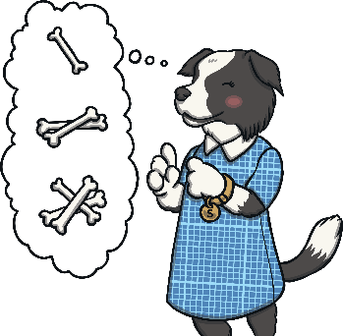
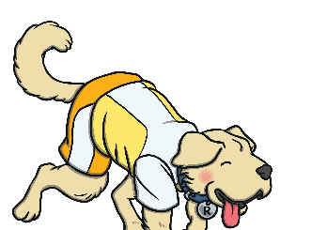
SATs Content Domain Coverage
In the KS1 reading tests, your child’s understanding of reading is tested through five different strands, known as ‘content domains’. These content domains are:
Inference Iggy Content Domain 1d:
Make inferences from the text.
Vocabulary Victor
Content Domain 1a:
Draw on knowledge of vocabulary to understand texts.
Sequencing Suki
Content Domain 1c:
Identify and explain the sequence of events in texts.
Predicting Pip Content Domain 1e:
Predict what might happen on the basis of what has been read so far.
Rex Retriever
Content Domain 1b: Identify/explain key aspects of fiction and non-fiction texts such as characters, events, titles and information.
Getting your child used to answering questions from each of these content domains prepares them for the SATS reading assessment. Asking a few questions per night will build your child’s experience.
Notes:
Introduce parents and carers to the Year 2 SATs using the Totally Pawsome Gang to cover each content domain.

Slide 37
Vocabulary
Vocabulary Victor will help your child to explore how and why authors and poets have chosen to use certain words and phrases.
Vocabulary Victor
Content Domain 1a:
Draw on knowledge of vocabulary to understand texts.
What does this word/sentence tell you about… (fiction feature/non-fiction subject matter)?
Can you find a word/sentence that tells you…/ shows you…/backs up what you have said about…?
Why did the author use the word… to describe…?
How does this word/description make you feel?

Slide 38
Retrieval
Rex Retriever will help your child to delve into a text and retrieve the facts exactly as they are written.
Rex Retriever
Content Domain 1b: Identify/explain key aspects of fiction and non-fiction texts such as characters, events, titles and information.
Where/when is the story/poem set?
Is this character a good/bad character? How can you tell?
Is there a dilemma in the story? What is it? How is the dilemma resolved?
Find your favourite description of the…

Slide 39
Sequencing
Sequencing Suki likes everything in order! She will help your child to sequence events in a text and to discuss the order in which things happen.
Sequencing Suki
Content Domain 1c:
Identify and explain the sequence of events in texts.
How/where does the story/poem/non-fiction text start?
Which character do we meet first?
What is the first/second/last step in these instructions?
Put these sentences into the order they happened in.

Slide 40
Inference
Inference Iggy will help your child to hunt for clues in a text about how someone might be feeling or why something is happening.
Inference Iggy Content Domain 1d:
Make inferences from the text.
What do you think… is saying/thinking/feeling at this point? Why?
What do you think the author meant when…?
Why does the author use the word … here?
How do you think the author feels about …? Find words to back this up.

Slide 41
Prediction
Predicting Pip tries to see the future and she will help your child to work out what might happen next based on what they have already read.
Predicting Pip Content Domain 1e:
Predict what might happen on the basis of what has been read so far.
What do you think will happen next?
Where do you think … will go next? Why?
What might you expect to see in this sort of text?
Can you think of any other stories like this? How do they end? Do you think this will end the same way?

Slide 42
Brilliant Book List Y2
Notes:
Share the Brilliant Book List Y2. Highlight that these are only suggestions of books that might be good to read together with your child throughout the year and does not provide an exhaustive list. Explain that it is important for children to find and read books that they are interested in so that they want to become lifelong readers.

Slide 43
Helping Your Child at Home
Talk about what can be inferred from the pictures before you read the text, e.g. ‘Why might the girl on the cover be sad?’
Discuss alternative words the author could have used, e.g. ‘Happy is a bit of a boring adjective, isn’t it? What word could we use instead?’
Make predictions and be able to justify them.

Slide 44
Helping Your Child at Home
Discuss the setting of the story. Have you read another book with the same setting? How does the setting in the first chapter differ to the setting at the end of the story?
Have you learnt anything while reading this book that you didn’t know before?

Slide 45
Reading Every Day
Reading to your child every day is just as important as hearing your child read to you.
Reading to your child will help your child to develop their understanding of what they hear. It can also inspire them to want to read for themselves.
Try to read to your child at a higher level than they can read by themselves.
Remember to talk about new words you come across together. Why not use a dictionary?

Slide 46
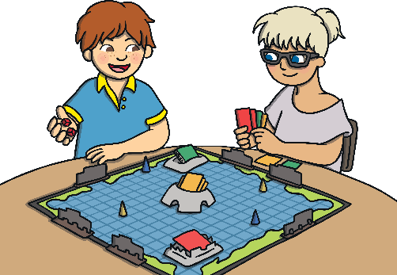
Reading Game Ideas
Playing simple reading games will help your child to see the relevance of reading while having fun.
Play board games that include reading. Ask your child to read out the clues.
Notes:
Share some simple games and ideas that families can do together at home to inspire a culture of reading.

Slide 47
Reading Game Ideas
Playing simple reading games will help your child to see the relevance of reading while having fun.
Ask your child to read menus, notices or posters when you are out and about.
Notes:
Share some simple games and ideas that families can do together at home to inspire a culture of reading.

Slide 48
Reading Game Ideas
Playing simple reading games will help your child to see the relevance of reading while having fun.
What was the best thing about school today?
Hide notes with words or sentences on around the house. Encourage your child to hunt for them and to read the notes that they find.
I love playing games.
Notes:
Share some simple games and ideas that families can do together at home to inspire a culture of reading.

Slide 49
Stage by Stage Reading Descriptors
Stage 1 (no words) - Child handles book carefully, holds the book the correct way up and is able to turn the pages. Child shows interest in the illustrations, recognises familiar characters and is able to tell a simple story.
Stage 1 (with words) - Child knows that print carries meaning and that in English we read from left to right and from top to bottom of the page. Child recognises names of familiar characters in the text. Child is beginning to use phase 2 sounds and recognise very simple HFWs. Child is able to describe main story in simple language.
Stage 1+ - As stage 1 with words plus able to read set 1 HFW. Child is exposed to the idea of pausing at a full stop in the sentence. Child can answer simple what and who questions and shows increasing recall when reading.

Slide 50
Stage 2 - Child is beginning to use some phase 3 sounds, makes some attempts at segmenting and blending and is able to point to the words they are reading. Child is starting to read a few words by sight. They are able to answer simple questions about the book they have read and can anticipate key events in the story.
Stage 3 - The child is no longer sounding out every word aloud as they read and can decode and/or sound out regular and irregular words. They can read and understand longer sentences and are able to answer simple thinking questions.
Stage 4 - A child’s reading begins to flow (less robot voice) and they can pause at full stops. They are able to read many HFWs on sight and decode unfamiliar words. They answer looking and thinking questions about the story and can retell events. They begin to read a wider range of books.

Slide 51
Stage 5 – Child’s voice when reading sounds like wavy water and they use punctuation to inform voice and pace. They can read many HFWs and irregular HFWs on sight. They are able to retell events in more detail and make predictions about events. They read a wider range of books including non-fiction and simple poetry.
Stage 6 – Pace, flow and intonation are in the main appropriate throughout the story and children are able to adapt to reading a range of texts. The child sees similarities and differences in the stories they read and can link events with personal experiences. Children are able to talk about characters feelings and motivation.
Stage 7 – Pace, flow and intonation are appropriate and children can change their voice when a character speaks. Children can retell a story in detail, answer look, clue and think questions and make offer their own opinions on a story. They understand the majority of the vocab and can make a good guess about the meaning of new vocab in the context of the story.

Slide 52
Stage 8 – Children’s reading is mainly fluent and accurate at a steady pace/flow. They are able to swiftly, mentally decode HFWs and use phonic skills to work out unfamiliar words. Children are able to retell in great detail and discuss favourite words and phrases. They are able to link events in a story with their own experiences and read beyond O.R.T.
Stage 9 – As above plus children can make and discuss their own choices about reading materials. They consistently use appropriate expression. They are able to answer some inference questions. They can discuss the sequence of events and retell stories with great accuracy/detail.
Stage 10 – As above plus children can link reading to their own experiences with clarity. They can make a sensible choice of reading matter, locate information in a text and use it to answer questions.

Slide 53
Have you got any questions?

